Slide 1

ML & Pathology
Liron Pantanowitz MD PhD MHA
Chair & Professor of Pathology
Department of Pathology UPMC/Pitt
LIRON@PITT.EDU

Slide 2
DISCLOSURE
Consultant for AiXMed, Hamamatsu & NTP
Medical advisory board for Ibex
Co-founder of LeanAP Innovators & Placenta AI

Slide 3
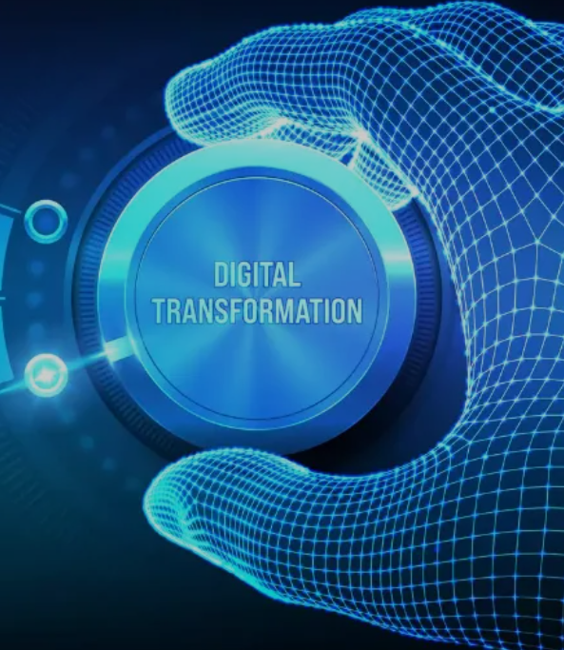
OBJECTIVES
Define computational pathology
Applications of AI in pathology
Feasibility of using AI in practice
Future applications of AI-ML

Slide 4
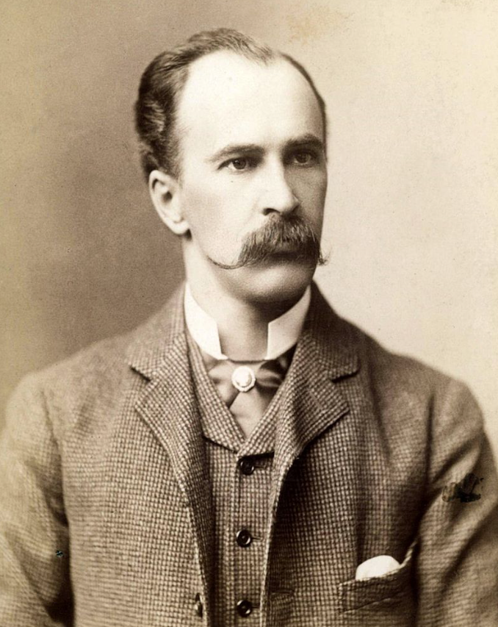
“As is our Pathology, So is our Practice” Sir William Osler (1849-1919)
Understanding of disease (pathology) directly influences the way (quality) medicine is practiced.
Further emphasizes the importance of integrating scientific knowledge with clinical practice.
Underscores the need for us to continually learn and adapt to new developments in medicine.
Wikipedia.org

Slide 5
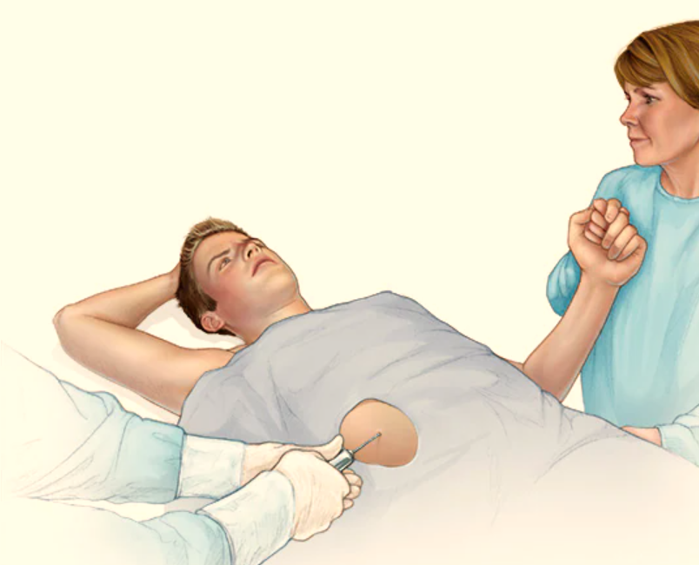
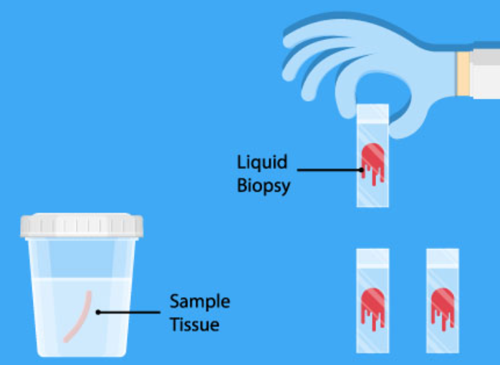
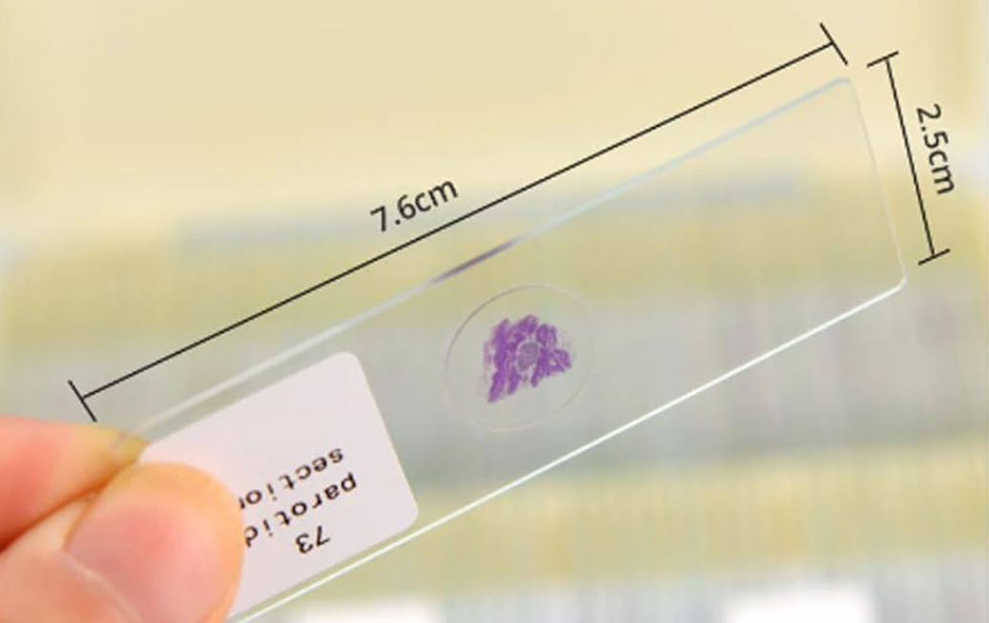
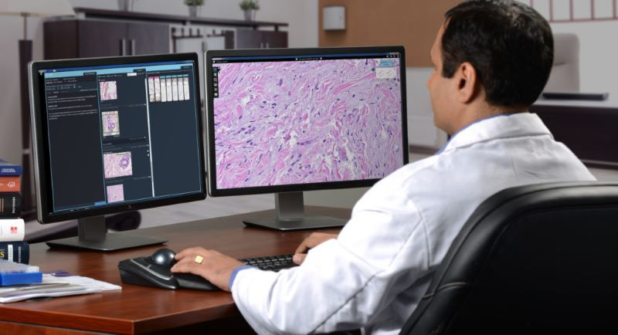
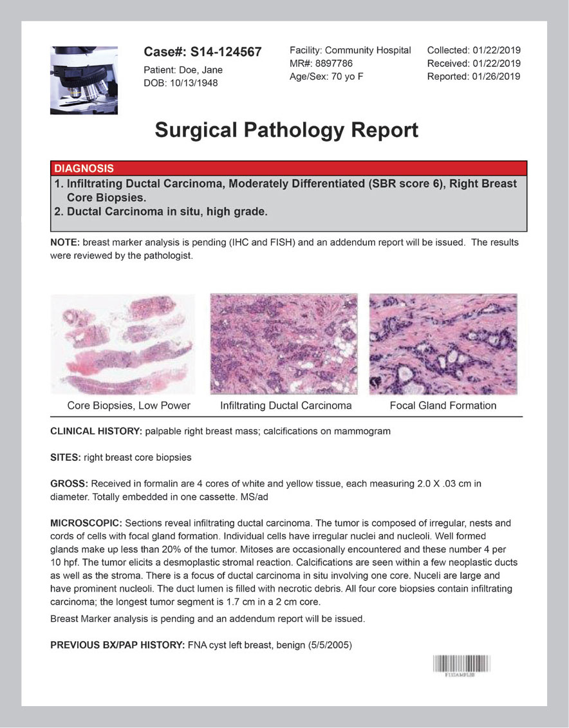
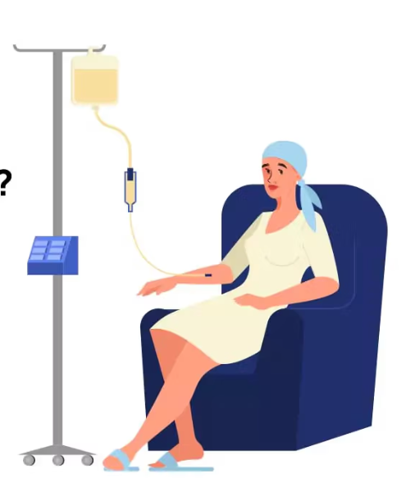
Pathology Workflow
Pre-Analytical Analytical Post Analytical

Slide 6
Pathology Workflow
Pre-Analytical Analytical Post Analytical
Patient

Slide 7
Pathology Workflow
Pre-Analytical Analytical Post Analytical
Patient Specimen
Blood
Tissue
Organ
Etc

Slide 8
Pathology Workflow
Pre-Analytical Analytical Post Analytical
Patient Specimen Sample
Blood
Tissue
Organ
Etc
Glass slides
Ancillary tests
DNA / RNA
Etc

Slide 9
Pathology Workflow
Pre-Analytical Analytical Post Analytical
Patient Specimen Sample Diagnosis
Blood
Tissue
Organ
Etc
Glass slides
Ancillary tests
DNA / RNA
Etc
Microscopic
Digital analysis
Instrument assay
Molecular
Etc

Slide 10
Pathology Workflow
Pre-Analytical Analytical Post Analytical
Patient Specimen Sample Diagnosis Report
Blood
Tissue
Organ
Etc
Glass slides
Ancillary tests
DNA / RNA
Etc
Microscopic
Digital analysis
Instrument assay
Molecular
Etc

Slide 11
Pathology Workflow
Pre-Analytical Analytical Post Analytical
Patient Specimen Sample Diagnosis Report Therapy
Blood
Tissue
Organ
Etc
Glass slides
Ancillary tests
DNA / RNA
Etc
Microscopic
Digital analysis
Instrument assay
Molecular
Etc

Slide 12
Pathology Workflow
Pre-Analytical Analytical Post Analytical
Patient Specimen Sample Diagnosis Report Therapy
Blood
Tissue
Organ
Etc
Glass slides
Ancillary tests
DNA / RNA
Etc
Microscopic
Digital analysis
Instrument assay
Molecular
Etc
Genes Mutation Target
Personalized (precision) medicine = medical approach that tailors treatment and healthcare decisions to the individual characteristics of each patient

Slide 13
Pathology Divisions
Anatomic Pathology & Centers of Excellence
Clinical Pathology (Lab Medicine)
Molecular & Genomic Pathology
Computational Pathology & Informatics
Translational Pathology
Experimental Pathology
Community Pathology

Slide 14
Pathology Divisions
Types of EHR Data
Text data (AP-LIS)
-Pathology reports (free text vs. templates)
-Unstructured vs. Structured (fields, synoptic)
-Typos affect NLP
Tabular data (CP-LIS)
-Tables
-Missing values
Image data (DP-IMS)
-Brightfield & Darkfield (fluorescence)
-Whole slide imaging (DICOM vs other formats)
-Barcoded slide labels serve as identifiers
-Labels (diagnoses), annotations & metadata
Universal data issues
-Silos (within legacy systems)
-Limited discrete data
-De-identification of PHI
-Difficulty with extraction
-Often RTF or PDF files
-Coding (LOINC, CPT, etc)
Anatomic Pathology & Centers of Excellence
Clinical Pathology (Lab Medicine)
Molecular & Genomic Pathology
Computational Pathology & Informatics
Translational Pathology
Experimental Pathology
Community Pathology

Slide 15
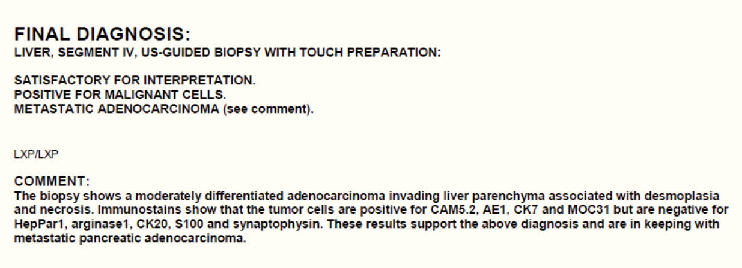
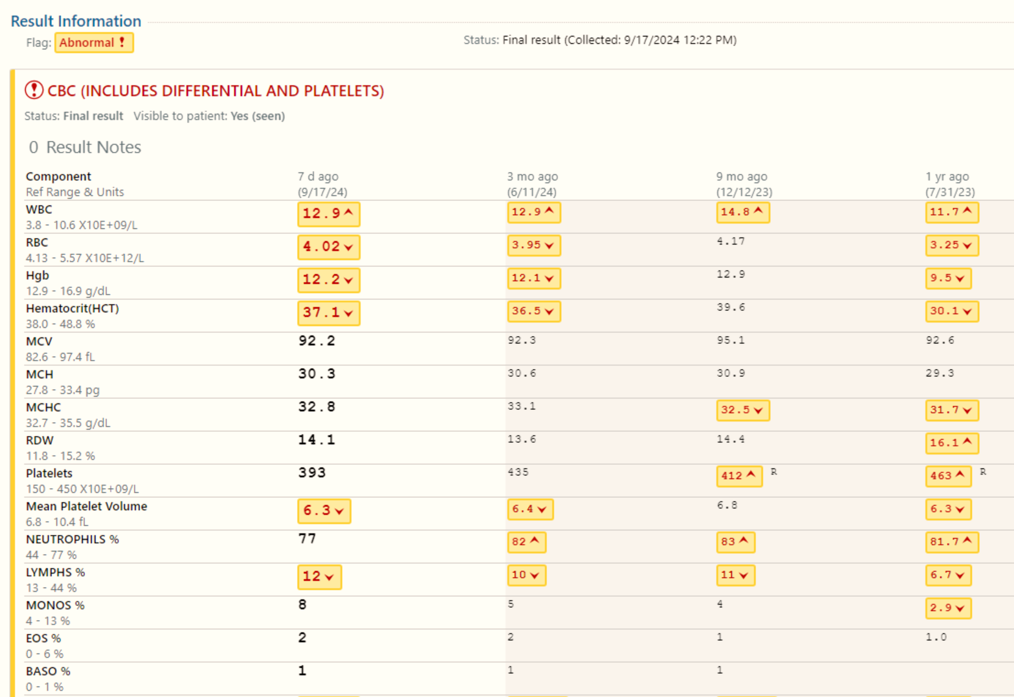
Pathology Data
Reports (Text)
Laboratory Data
Results (Tabular)

Slide 16
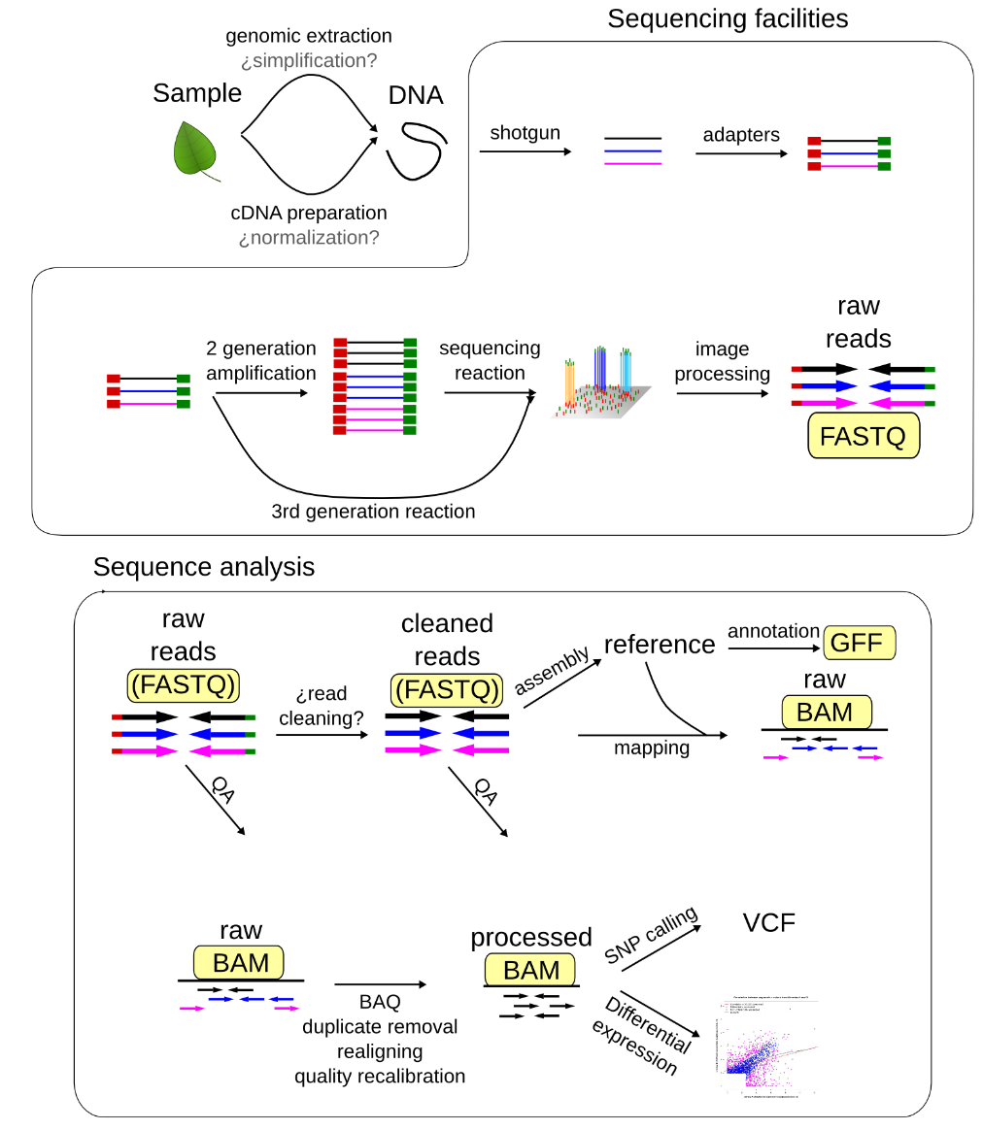
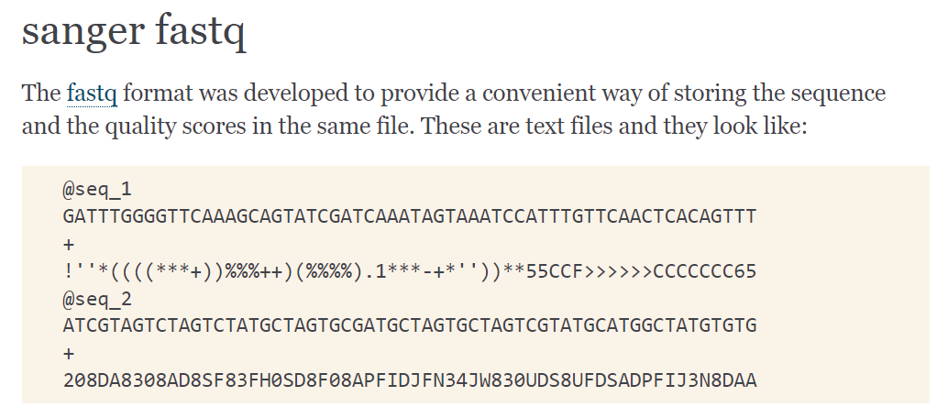
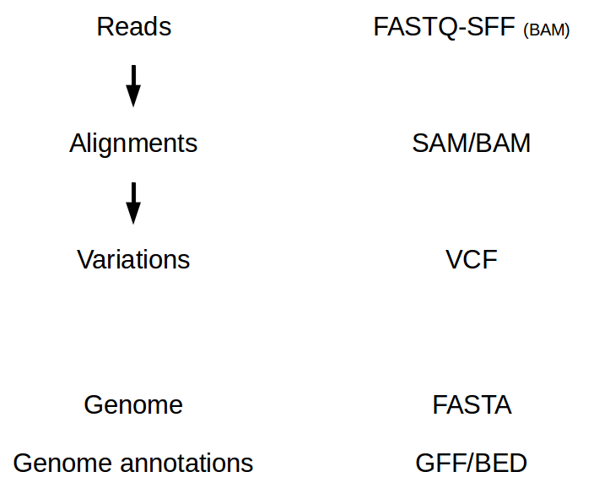
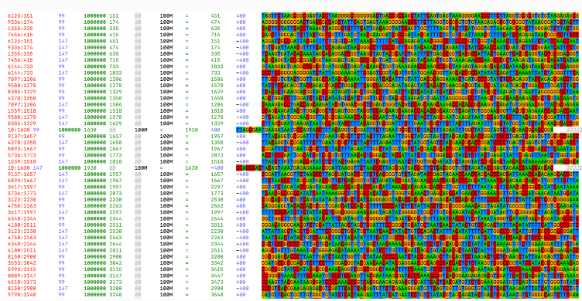
NGS File Formats
NGS file formats — Bioinformatics at COMAV 0.1 documentation (upv.es)

Slide 17
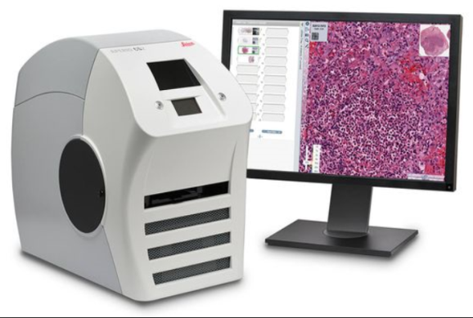
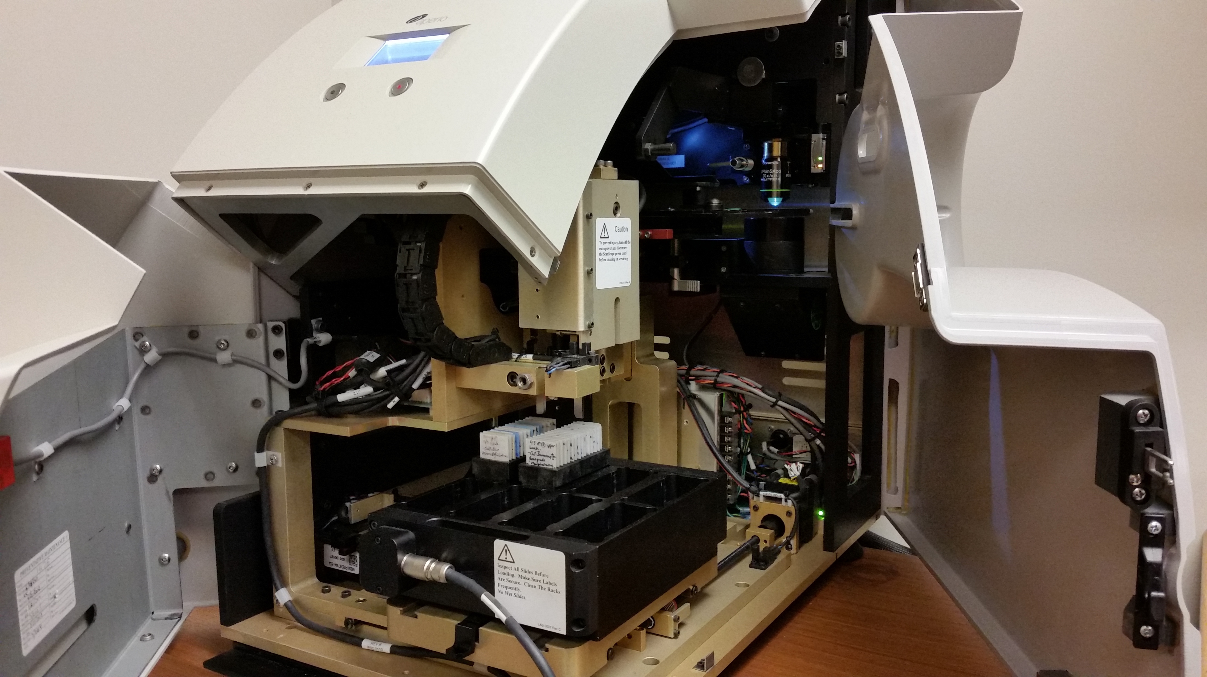
Slide scanning
Slide handling
Slide loading

Slide 18
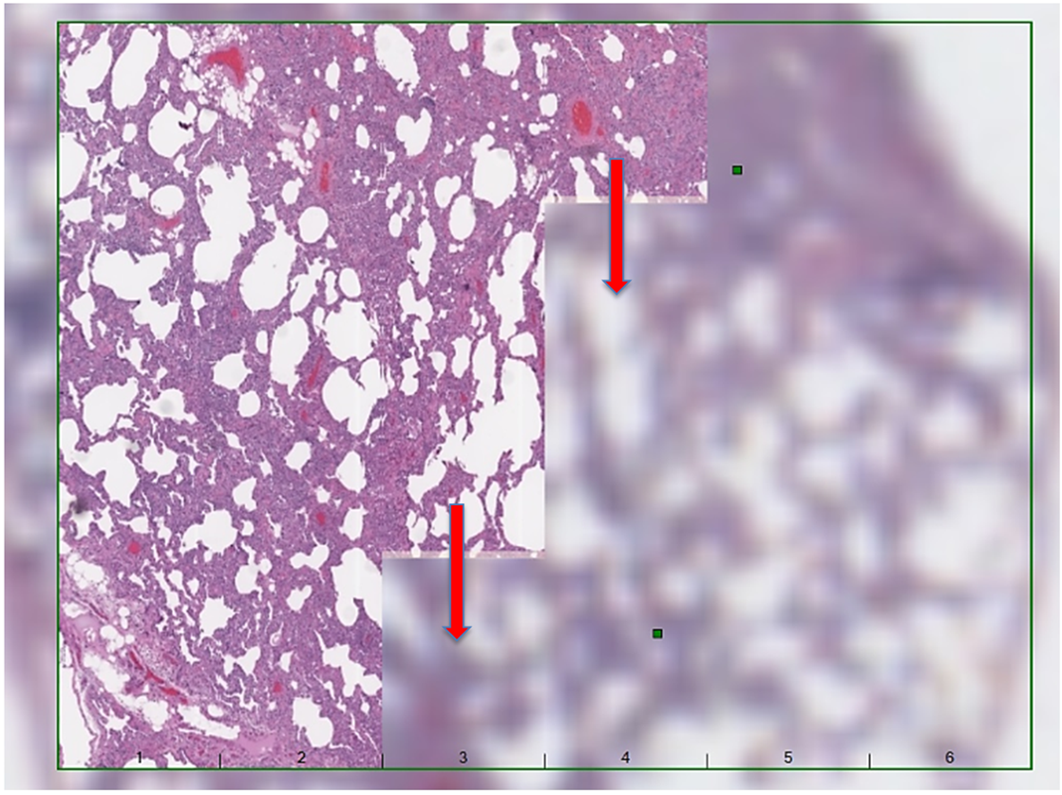
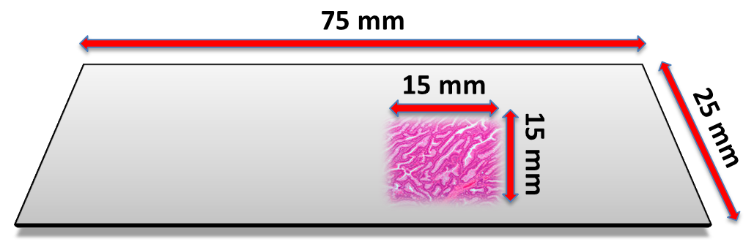

Scanning (Digitization)
SLIDE

Slide 19
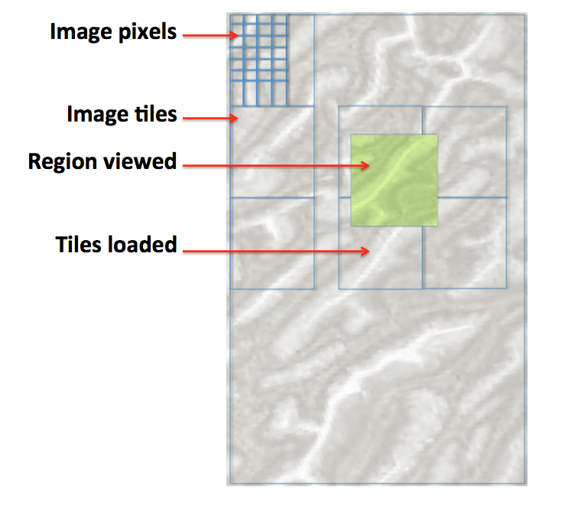
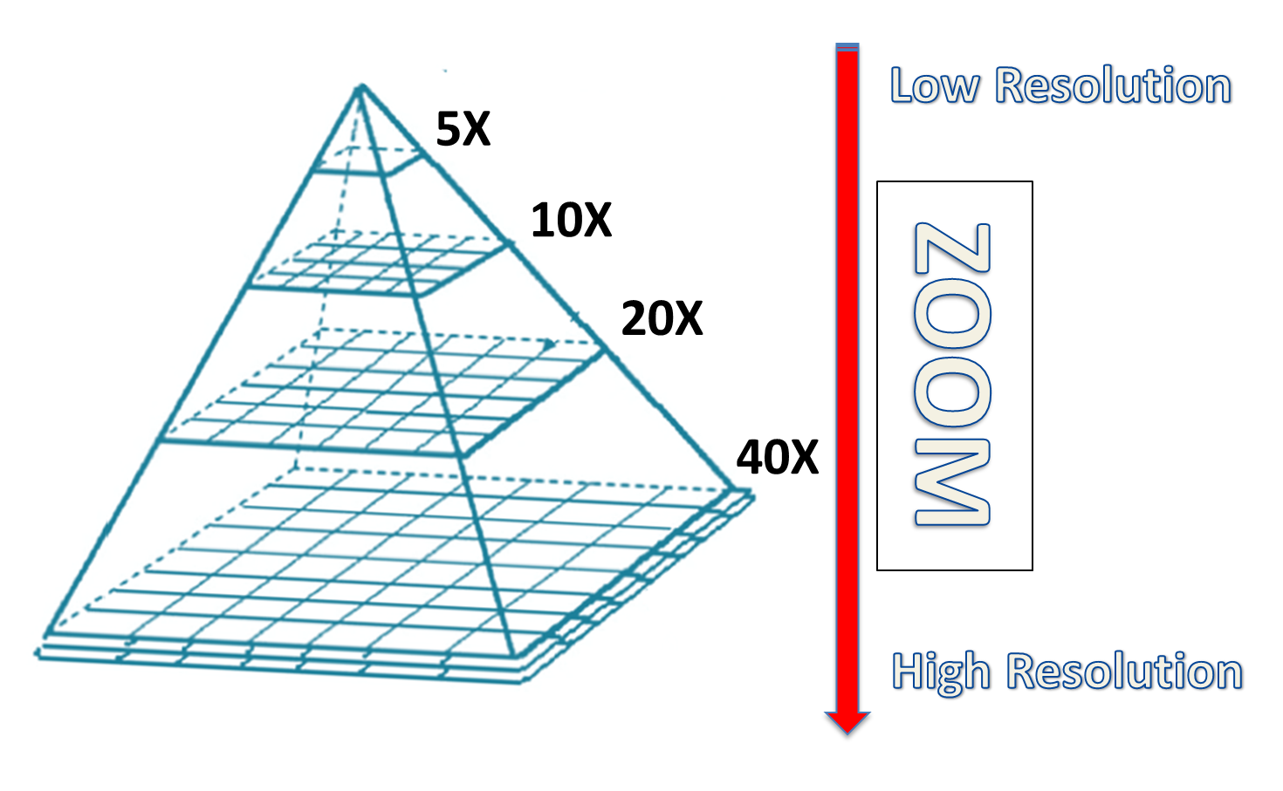
WSI FILES
Various proprietary file formats (e.g. Aperio SVS, Hamamatsu NDPI, Philips TIFF, 3DHistech MRXS, Motic MDS, Olympus VSI, Zeiss CZI), as well as Digital Imaging and Communications in Medicine (DICOM)

Slide 20
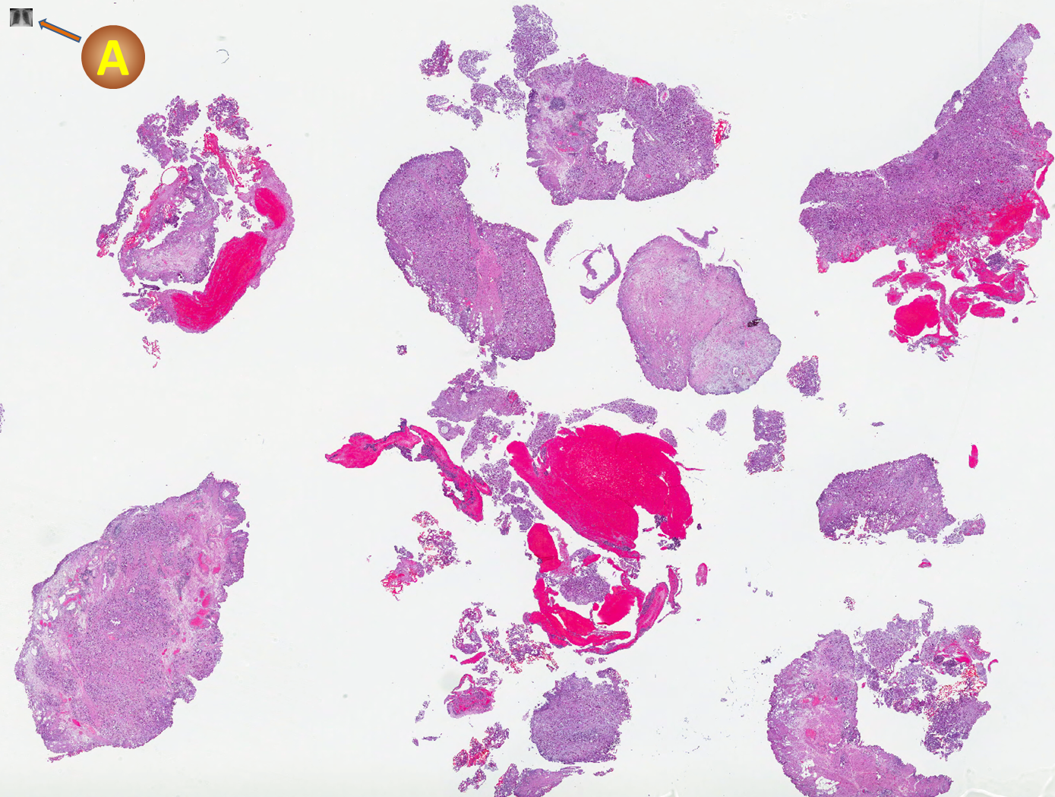
CXR
WSI file size can vary depending on several factors (e.g. amount of tissue area scanned, lens magnification used - 10x vs. 40x, Z-stacking/ # of focal planes scanned, compression).
e.g. WSI file of a tissue sample measuring 20mm x 15mm scanned at 0.25 microns/per pixel can be 4.8 gigapixels (~80,000 x 60,000 pixels).
WSI (biopsy at 40x scan 654Mb with 20:1 loss compression) vs chest x-ray (pixel-normalized display)
Pantanowitz et al. Pathology Informatics. ASCP Press. 2012.

Slide 21
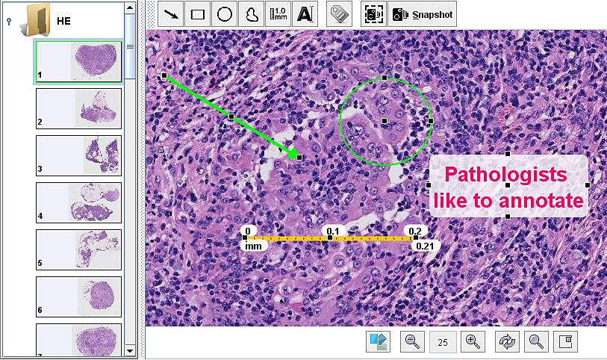
Image Annotation
Creating annotated datasets is important for supervised learning.
Open-source software
-QuPath; https://qupath.github.io Commercial tools
-(e.g. V7).
Annotations can be exported in text format (e.g. JSON, XML).

Slide 22
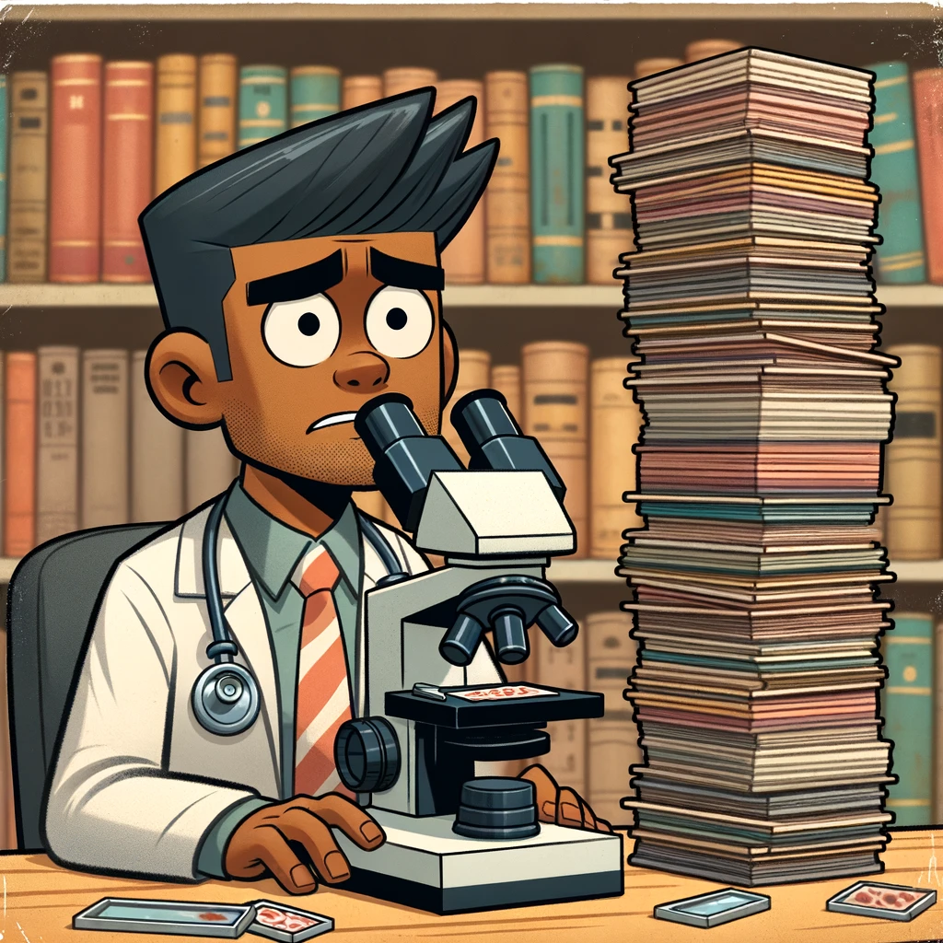

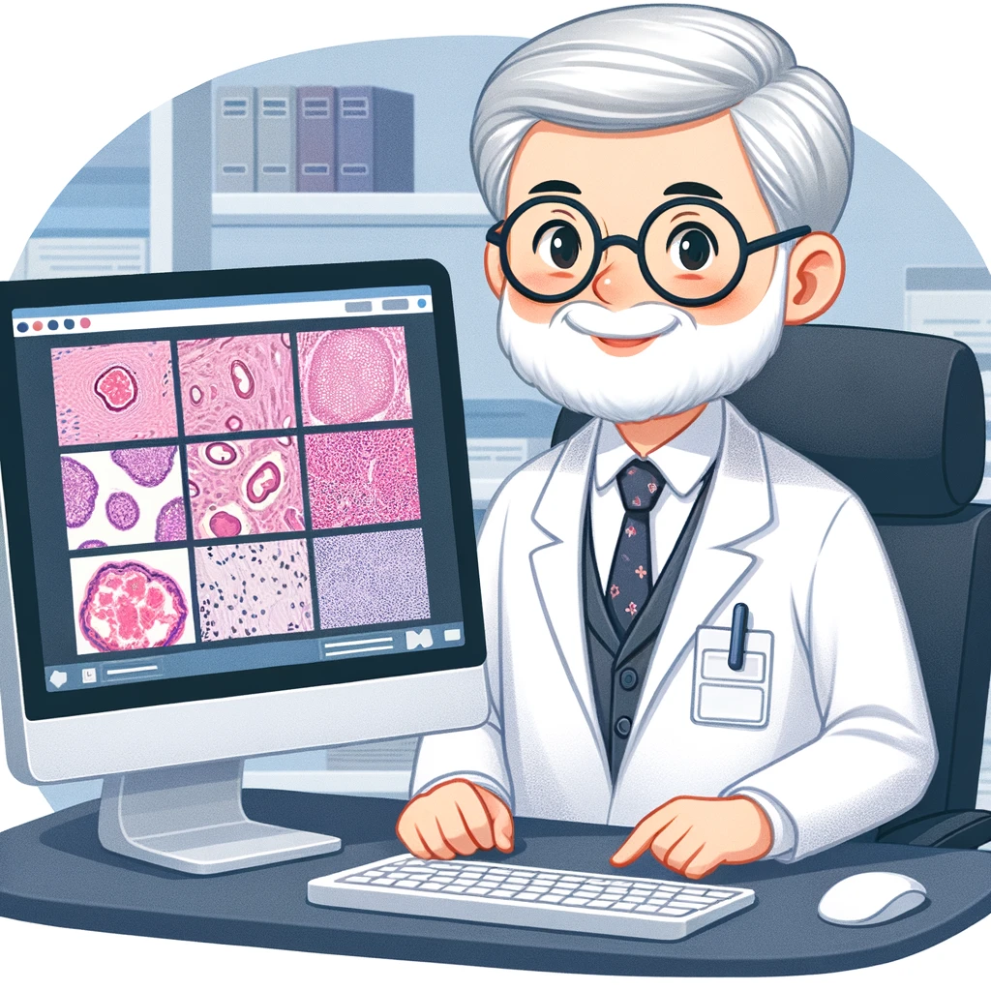
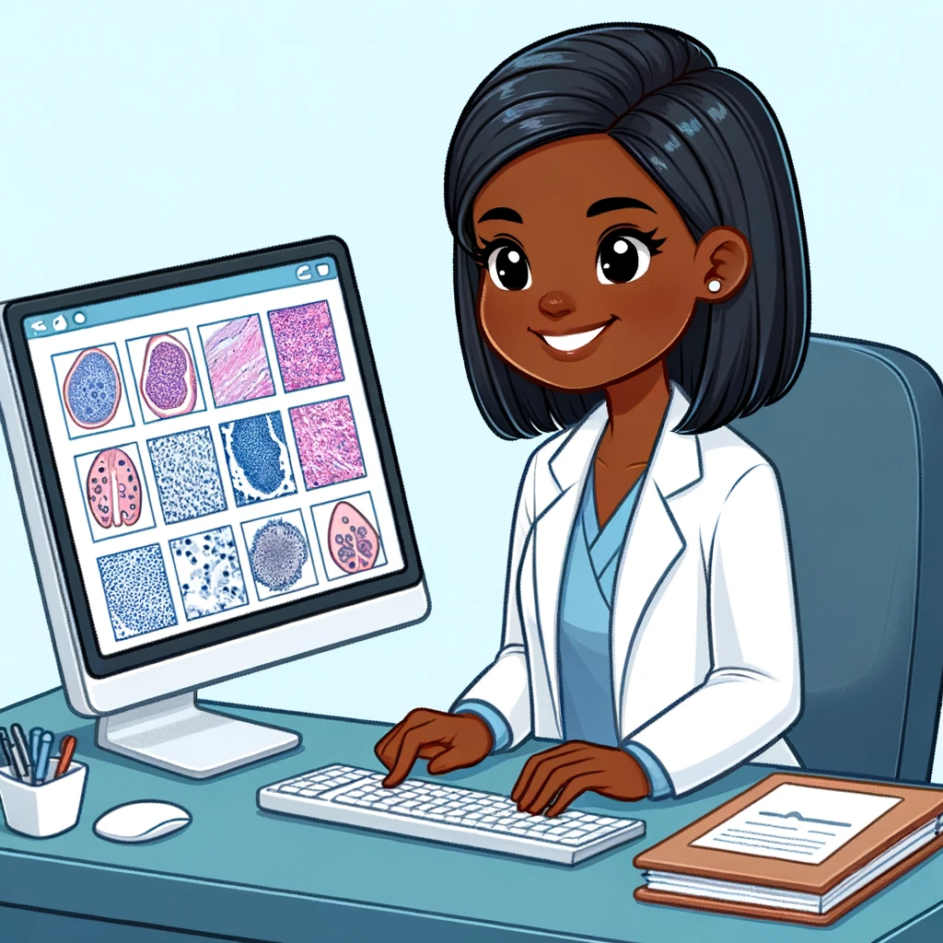
Pathologists
Without AI
Pathologists
With AI
Artist Dr Hooman Rashidi using DALL-E

Slide 23
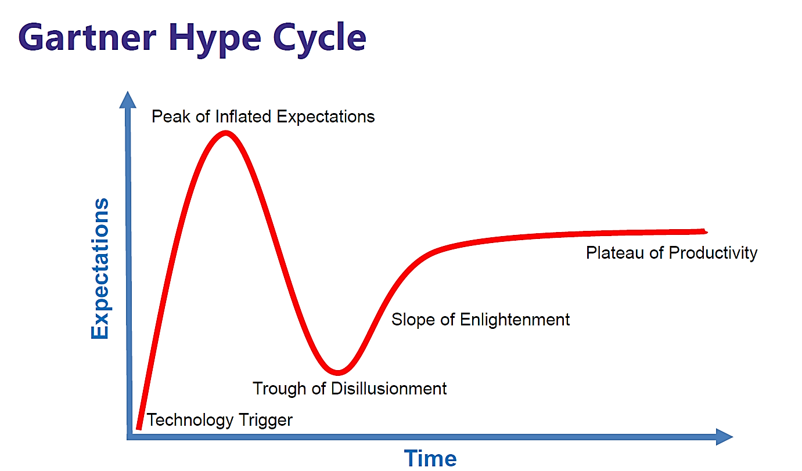


Slide 24

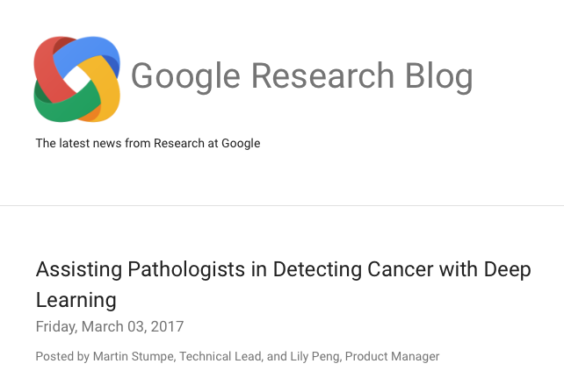
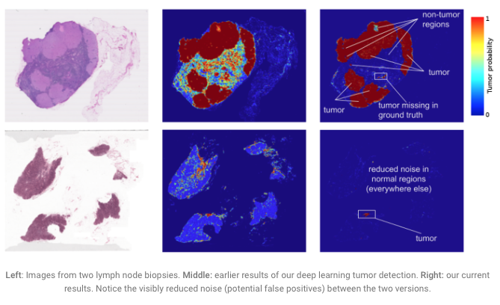
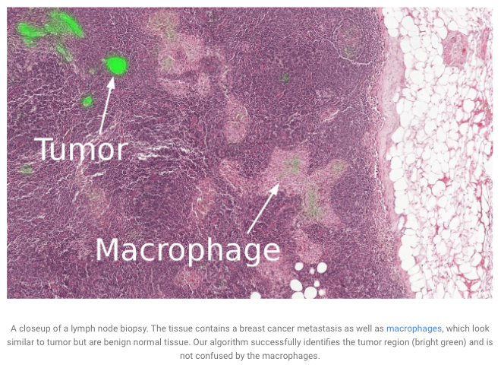
Google uses AI to detect lymph node metastatic breast carcinoma

Slide 25
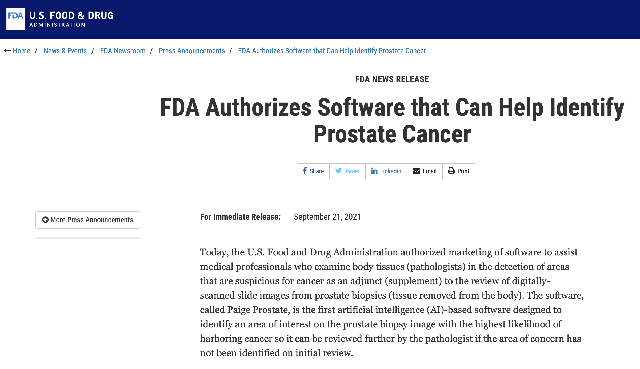
https://www.fda.gov/news-events/press-announcements/fda-authorizes-software-can-help-identify-prostate-cancer

Slide 26
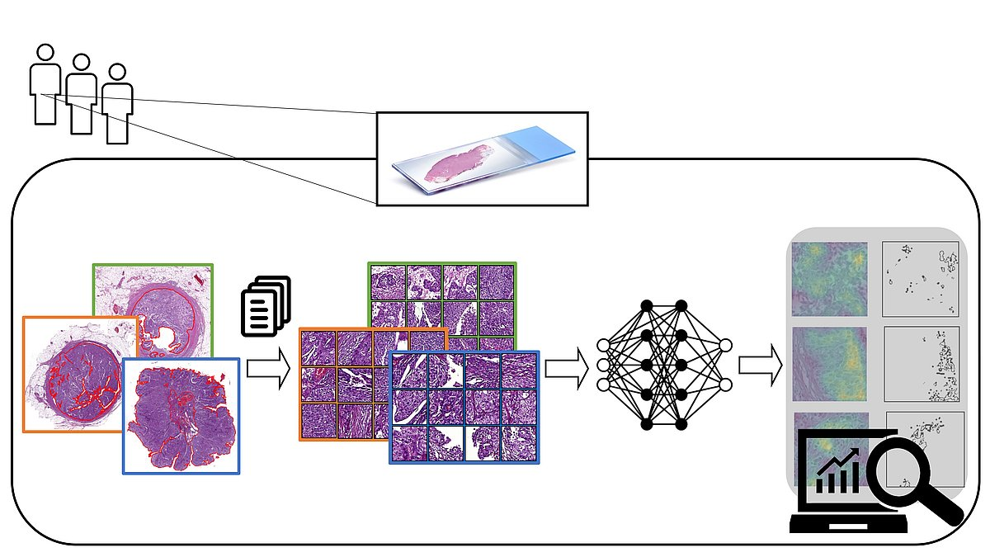
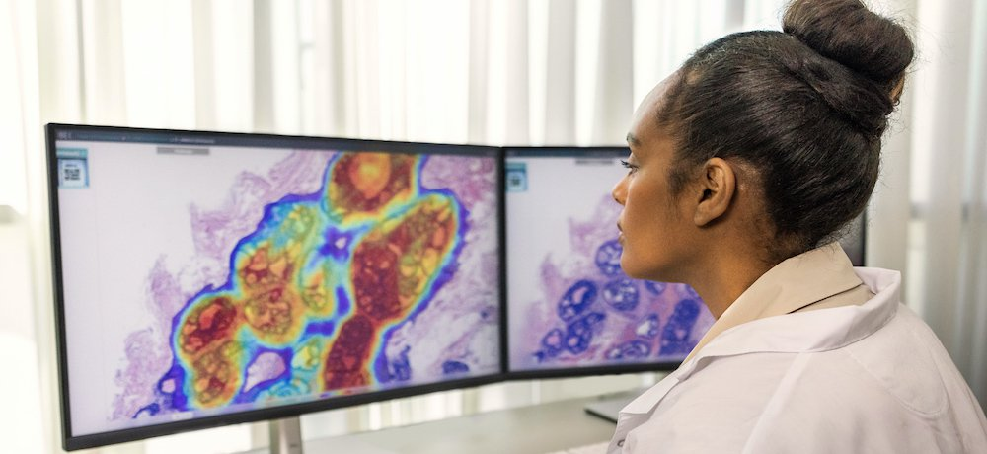
Computational Pathology
Published definition: An approach to diagnosis that:
Incorporates multiple sources of raw data
Extracts relevant information from those data
Uses mathematical models to generate conclusions
Presents knowledge to help with medical decisions
My definition: AI applied to Pathology & Lab Med
(Copyright: Miriam Angeloni, Fulvia Ferrazzi)
Fuchs TJ et al. Med Image Comput Comput Assist Interv 2008; 11:1-8
Louis DN et al. Arch Pathol Lab Med 2014; 138:1133-1138
Med-Tech Innovation News 2022)

Slide 27

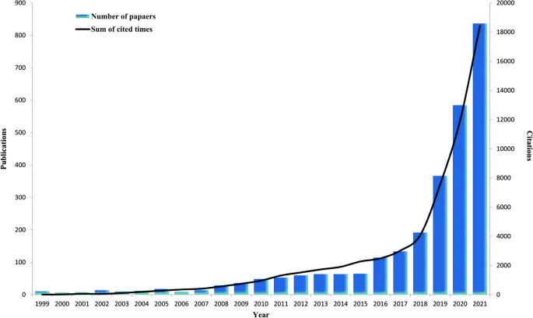
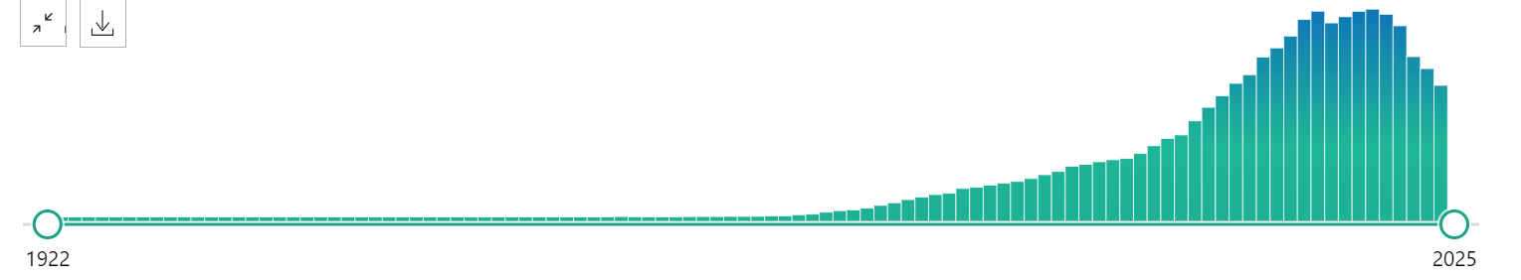
Computational Pathology Literature
Total = 34,863 articles
Citations for AI-based tumor pathology research
2019 (peak) =19,464 results
1944 = 1 paper
2024 (so far) = 12,235 papers
Shen et al. J Transl Med 2022; 409

Slide 28
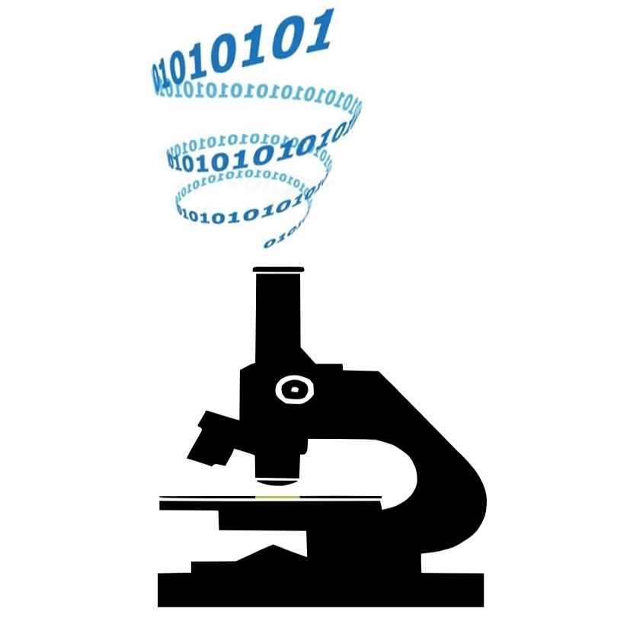
Applications of AI in Pathology
Detect rare events (e.g. microorganisms, cancer)
Automatically quantify features in digital images
Diagnose diseases (e.g. cancer) from digital slides
Make prognostic predictions by analyzing pixels
Discovery (e.g. biomarker research, clinical trials)

Slide 29
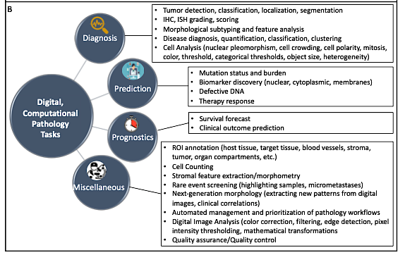
Waqas A et al. Lab Invest. 2023 Nov;103(11):100255. PMID: 37757969

Slide 30
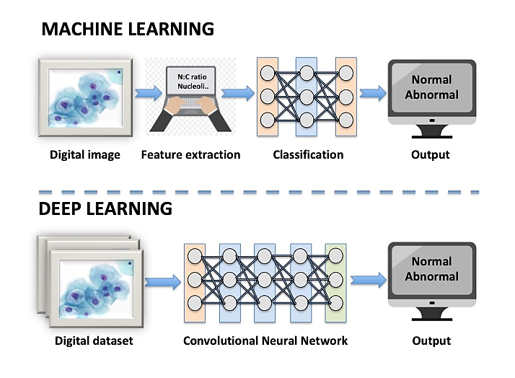
Problems Common to all Deep Learning
Supervised Learning
Lack of readily available datasets
Time to generate datasets (label data), especially if supervised data
Significant investment in computer hardware & human skills
Performance & generalizability
Blackbox problem to troubleshoot
Regulatory oversight & validation
Unsupervised Learning
Cheng J et al. American J Pathology 2021; 191:1684-1692

Slide 31

GIGO Principle

Slide 32
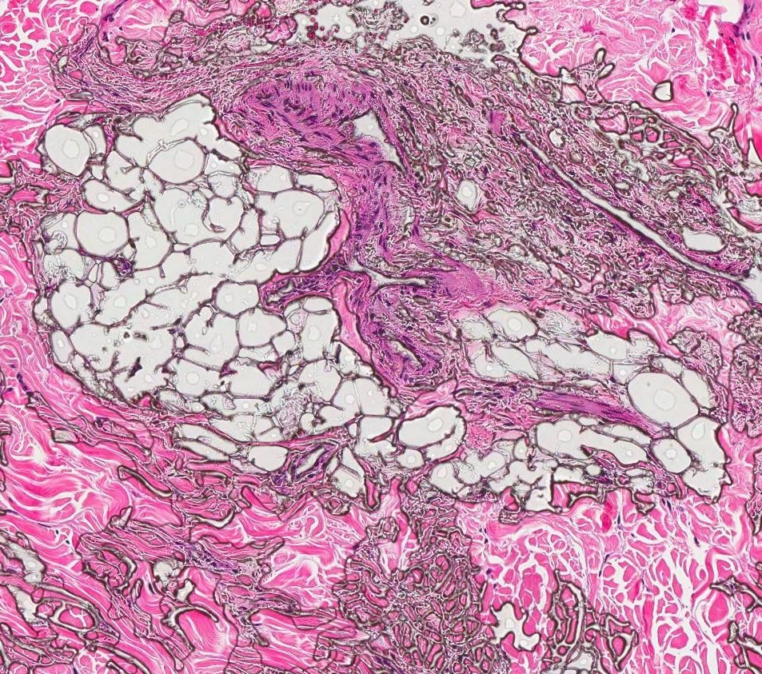
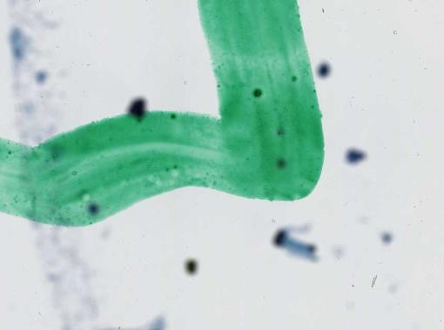
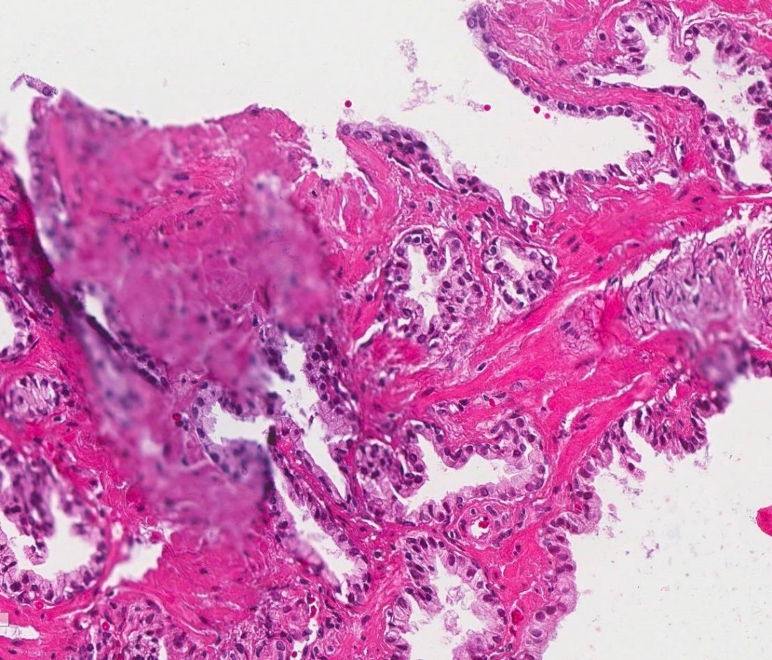
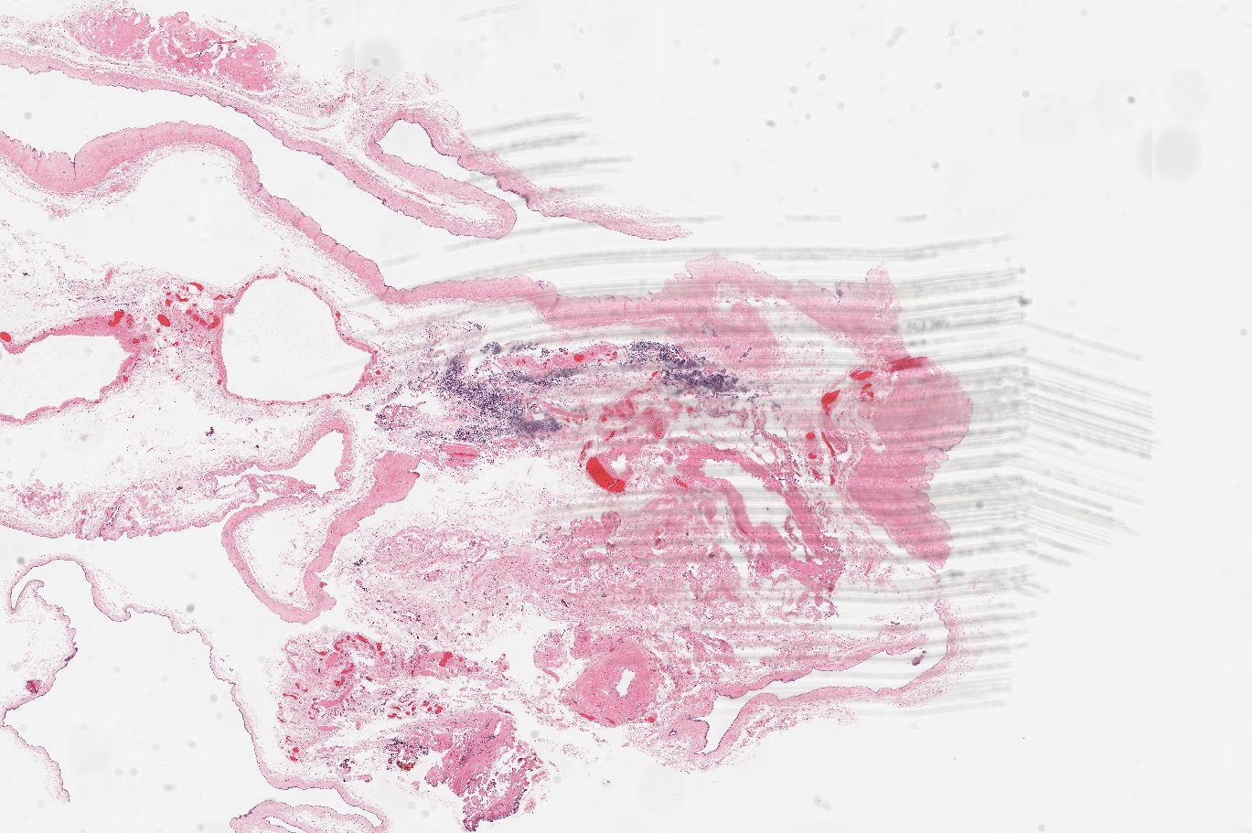
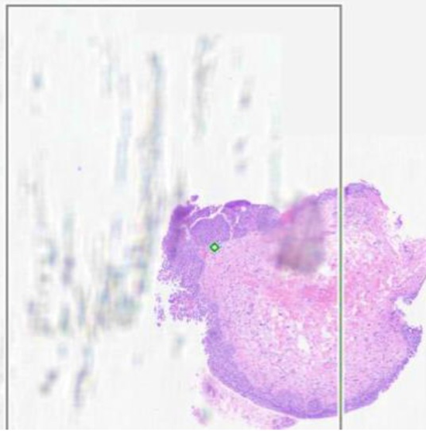
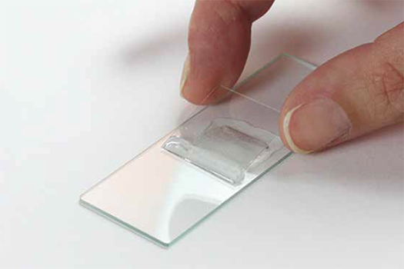
Slide Artifacts
Air bubbles
Excess mounting medium
Pen markings
Wax dirt
Scratched tape coverslip

Slide 33
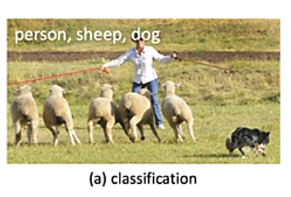

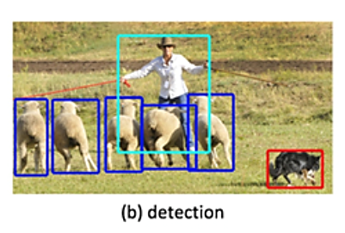
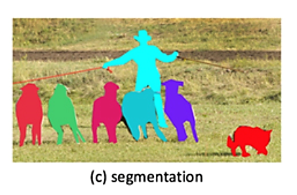
Quantitative Image Analysis
Classification
Detection
Segmentation
Feature extraction
Quantification

Slide 34
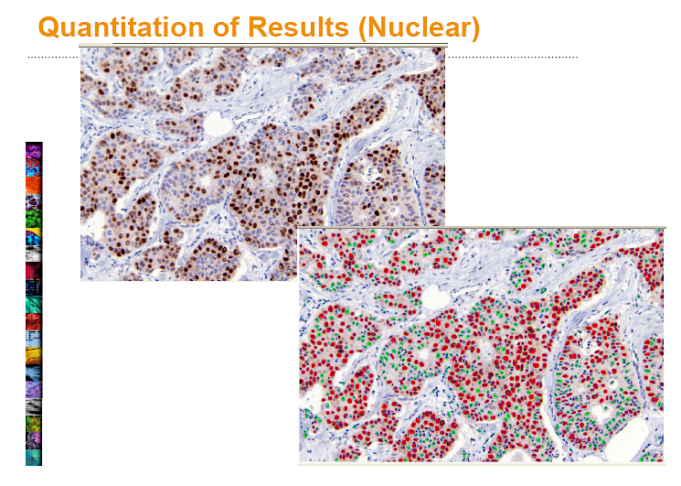


Slide 35
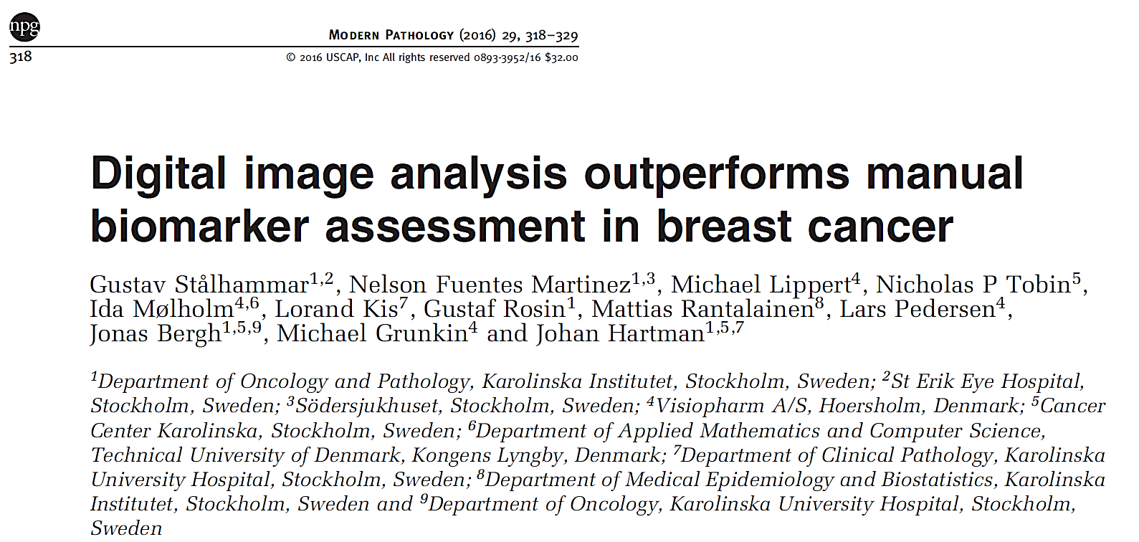
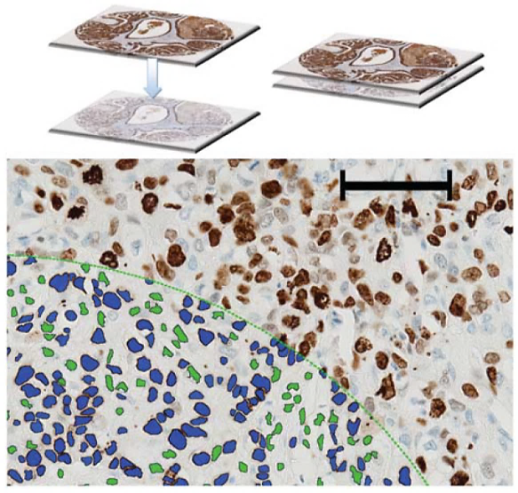

Slide 36
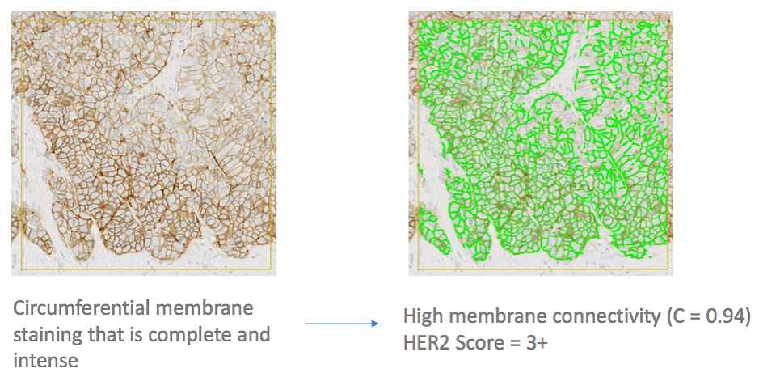
QIA for HER2/neu by IHC
True (3+) Positive

Slide 37

QIA for HER2/neu by IHC
True (3+) Positive
False Positive

Slide 38

Deep Learning & Digital Pathology
Patch sampling (usually squares)
Most image patches are 256 x 256 pixels
Gigapixel WSI
Detection
Segmentation
Quantification
Classify OOIs
A CNN can be used to train and predict
patient-, slide-, and/or patch-level characteristics
Supervised
Learning

Slide 39

Model development & deployment pipeline
Harrison et al. APLM 2021; 145:1228-1254

Slide 40


Explainable AI
Heat Maps
Image Galleries

Slide 41

Example: GalenTM Breast (Ibex)

Slide 42


Slide 43




DCIS (x20)
IDC (x20)
TILs Detection: AUC 0.87
TIL heatmap (x20)
TIL heatmap (30%) (x20)

Slide 44




Where to Insert AI Tools?
Primary Diagnosis
Scanning

Slide 45

Where to Insert AI Tools?
Primary Diagnosis
Scanning
First read: AI to rescan, triage cases, screen, pre-order, pre-diagnose, sign-out negative cases

Slide 46

Where to Insert AI Tools?
Primary Diagnosis
Scanning
First read: AI to rescan, triage cases, screen, pre-order, pre-diagnose, sign-out negative cases
Second read: AI to perform tasks only when directed (grade, confirm diagnosis, offer a differential)

Slide 47

Where to Insert AI Tools?
AI for running QA
in the background
Primary Diagnosis
Scanning
First read: AI to rescan, triage cases, screen, pre-order, pre-diagnose, sign-out negative cases
Second read: AI to perform tasks only when directed (grade, confirm diagnosis, offer a differential)

Slide 48

AI-Assisted AFB Screening
More Accurate
Web Portal
Much Quicker
Pantanowitz et al. AJCP 2021; 156(1):117-128

Slide 49


Automated prostate gland segmentation
Aperio Phillips Ventana

Slide 50


Slide 51





Missed cancer case originally diagnosed as benign
The Lancet Digital Health 2020 2e407-e416DOI: (10.1016/S2589-7500(20)30159-X)

Slide 52

Questions About Using AI in Pathology
What are the right tasks for AI in Pathology (i.e. killer app)?
What is the right evidence for using AI (FDA, publications)?
How do we pay for AI tools and get reimbursed (CPT code)?
How do we deploy IT in the lab (e.g. cloud, integration)?
How do pathology trainees interact with AI (deskilled)?

Slide 53


Can AI do MORE than I can with my microscope?
Do we train algorithms to just replicate what we can do with a microscope (e.g. train to interpret cases that fit into existing classification systems), or
should we instead train AI systems to predict outcomes (e.g. histopathology from cytology, stain results from H&E, underlying genotype from phenotype, prognosis, predict response to therapy)?

Slide 54



Slide 56


Slide 57


Investigators from NYU
Trained a deep CNN on WSI of lung from TCGA
Network trained to predict 10 commonly mutated genes in lung adenocarcinoma
6 predicted from pathology images (AUC’s from 0.733 – 0.856)
Their approach can be applied to any cancer type
The code is available at: https://github.com/ncoudray/DeepPATH

Slide 58



COMMUNICATIONS BIOLOGY | (2023)6:304 | https://doi.org/10.1038/s42003-023-04583-x | www.nature.com/commsbio

Slide 59

Multimodal AI Models
Advanced ML models designed to process, integrate and link multiple data types (modalities).
Allows more comprehensive & contextually aware decisions, to improve AI-based diagnostics & predictions.
Boehm KM et al. Nat Rev Cancer 2022; 22(2):114-126

Slide 60

Generative AI
AI capable of generating text, images, code or other media
E.g. ChatGPT (GPT = generative pretrained transformer)
Common uses: creative writing, summarize text, translation, producing code, data mining, categorization, etc.
Capable of creating synthetic (new, fake) data
Pathology uses: automate report generation, diagnosis classification, synthetic data, etc.
Challenges: bias, ethics (e.g. deepfake), hallucinations
AI

Slide 61

Which Digital H&E Recut is Fake?

Slide 62

Which Digital H&E Recut is Fake?

Slide 63


No difference in how pathology personnel perceive real versus synthetic images
Implications for teaching & training algorithms.

Slide 64





Enhance our academic mission
Solve our problems with AI
Generate IP achieving 1 & 2
Computational Pathology & Ai Center of Excellence | Department of Pathology (pitt.edu)

Slide 65

AI Tool

